Slide 1
RESIN Schema Library HRF
Quizlet 9
Version: Feb 3, 2022

Slide 2
Scenarios
Disease Outbreak
IED Bombing
Terrorist Attack
Kidnapping
Business Change
Election
Sports Games
Mass Shooting
Civil Unrest
International Conflict
Disaster and Rescue

Slide 3
Disease Outbreak Schema Quizlet 9
Sha Li, Manling Li, Ghazaleh Kazeminejad, Michael Regan, Susan Brown, Martha Palmer, Jiawei Han, Heng Ji
{shal2,hengji}@illinois.edu

Slide 4
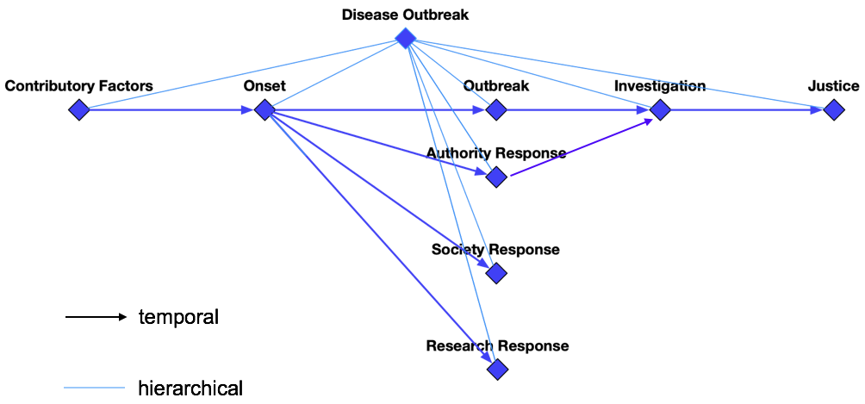
Overview

Slide 5
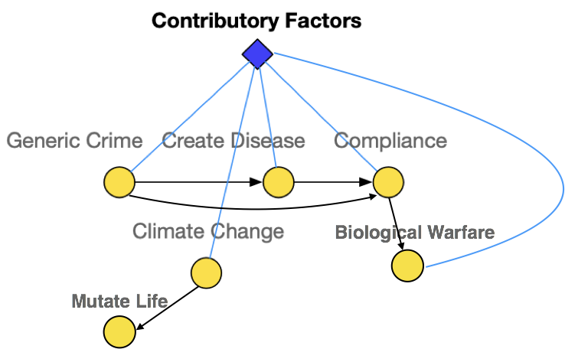
Contributory Factors
Generic Crime: The disease outbreak could be the result of a crime, i.e., someone polluting the water with a chemical
Compliance: Compliance to a rule or regulation. Often negated, for example violating health regulations.
Biological Warfare: The disease outbreak may result from the use of biological toxins or infectious agents such as bacteria, viruses, insects, and fungi with the intent to kill, harm or incapacitate humans, animals or plants as an act of war
Mutate Life: The virus may undergo an alteration in the nucleotide sequence of the genome during the disease outbreak

Slide 6
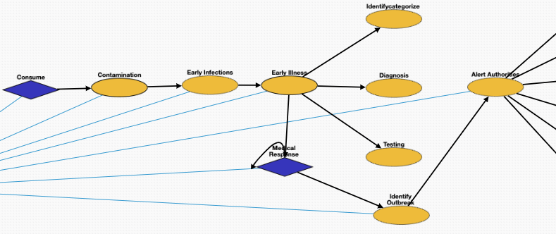
Onset
Consume: Consumption of a substance by an organism.
Contamination: Presence of an unwanted constituent, harmful substance or impurity in a material, physical body, or environment
Infections: Invasion of an organism's body tissues by the virus. People can be infected by the virus in the disease outbreak
Early Illness: Abnormal condition that negatively affects the structure or function of all or part of an organism due to the virus in the disease outbreak
Identify Outbreak: Detecting a possible outbreak. Usually accompanied by an announcement.
Alert Authorities: Alerting and reporting the detected outbreak to state and local public health authorities

Slide 7
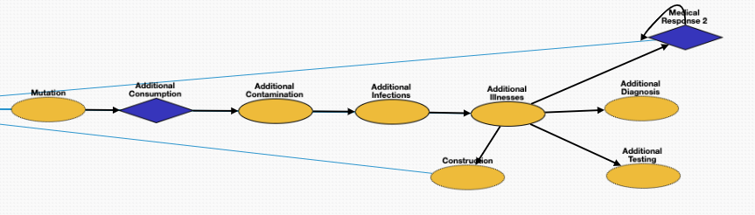
Outbreak
Mutations: The virus may undergo an alteration in the nucleotide sequence of the genome during the disease outbreak
Infections: Invasion of an organism's body tissues by disease-causing agents. People can be infected by the virus in the disease outbreak
Illness: Abnormal condition that negatively affects the structure or function of all or part of an organism due to infection of the virus in the disease outbreak
Construction: Field hospitals may be constructed to accommodate patients during the outbreak

Slide 8
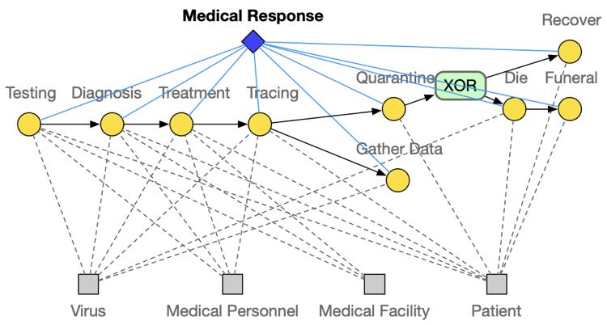
Medical Response
Testing: A viral test checks specimens from your nose or your mouth to find out if you are currently infected with the virus
Diagnosis: Medical diagnosis on infection of the virus in the disease outbreak
Treatment: Attempted remediation of a health problem due to infection of the virus in the disease outbreak
Tracing: Contact tracing identifies persons who may have come into contact with an infected person during the disease outbreak
Quarantine: Restriction on the movement of people, animals and goods which is intended to prevent the spread of the disease
Gather Data: Epidemiologic data collection
Die: Patients may die from the infection of the virus
Recover: Patients may recover from the infection of the virus
Funeral: A ceremony for patients died in the disease outbreak

Slide 9
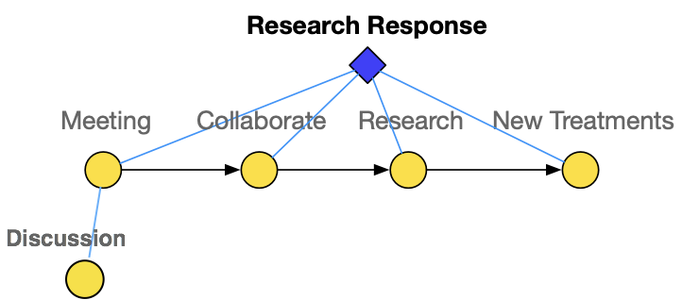
Research Response
Meeting: Academic conference or scientific conference for conducting research on fighting the virus
Collaborate: Research collaboration on finding treatment for the virus
Research: Conducting research fighting the disease outbreak
New Treatments: Developing effective treatment or cure for the disease
Discussion: conversation between two or more people on responding to the disease outbreak

Slide 10
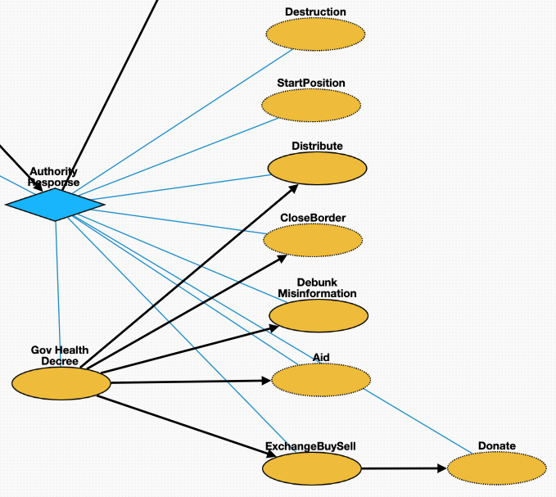
Authority Response
StartPosition: Officials are assigned to monitor, prevent, contain, and mitigate the disease outbreak
Destruction: The government destroys the source of the disease, for example, Haiti demolished the fishing nuts where the Cholera epidemic started.
Gov Health Decree: Legislations were issued fighting the disease outbreak by government
Debunk Misinformation: Debunking misinformation of related to the disease outbreak
Close Border: Border were closed to slow the spread of the virus
Distribute: Distributing the vaccines of the virus
Financial Aid: Financial assistance with food, housing and bills
ExchangeBuySell: Buying, selling or exchanging goods related to the disease outbreak
Donate: Charitable activities related to the disease outbreak

Slide 11
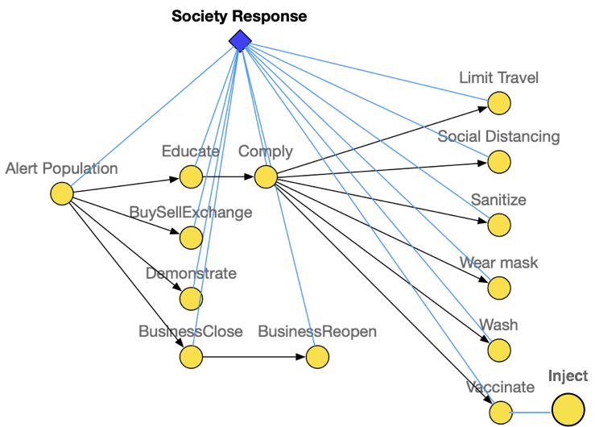
Society Response
Alert Population: Alerting population of the exposure of the virus
Educate: Sharing and educating related knowledge for fighting the disease outbreak
BuySellExchange: Buying, selling or exchanging goods related to the disease outbreak
Demonstrate: Protests over responses to the disease outbreak
BusinessClose: Business close due to the disease outbreak
BusinessReopen: Business reopen due to the disease outbreak
Comply: Complying to the government legislations
Limit Travel: Restrictions on traveling to slow down the spread of the virus
Social Distancing: Keep physical distance to prevent the spread of the disease
Sanitize: Disinfection to prevent infection of the virus
Wear Mask: Wearing masks to prevent the spread of virus
Wash: Washing hands to prevent infection
Vaccinate: Vaccine intended to provide acquired immunity against the virus
Inject: The act of administering a liquid, especially a drug, into a patient infected by the virus using a needle and a syringe

Slide 12
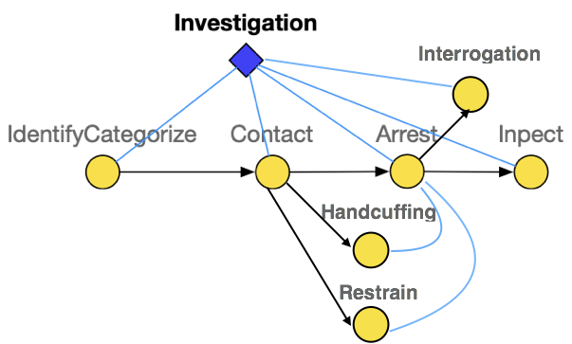
Investigation
IdentifyCategorize: Investigation of the disease outbreak includes identify the source of the virus as well as the suspect of the creator
Contact: Make contact with the suspect
Arrest: Taking the suspect who created the virus or violated laws during the outbreak into custody
Inspect: Organized examination or formal evaluation on the suspect for creating the virus
Interrogation: Interviewing with the goal of eliciting useful information related to suspected crime during the disease outbreak
Handcuffing: Using handcuffs to secure a suspect who violated law during the disease outbreak
Restrain: Physical restraint on the suspect

Slide 13
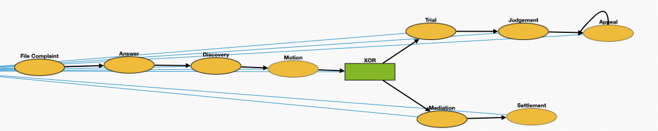
Civil Justice
File Complaint: Plaintiff files a complaint to initiate a lawsuit
Answer: In law, a solemn assertion in opposition to someone or something by the defendant
Discovery: Pre-trial procedure in common law countries for obtaining evidence
Motion: In US law, a procedural device to bring a limited, contested issue before a court for decision
Trial: Coming together of parties to a dispute, to present information in a tribunals on the case of creation of the virus
Judgement: The formal decision made by a court following a lawsuit
Appeal: Resort to a superior court to review the decision of an inferior court or administrative agency
Mediation: Dispute resolution with assistance of an impartial third party moderator through the use of communication and negotiation techniques
Settlement: The dispute is resolved through a payment of money.

Slide 14
RESIN IED Attack Schemas Quizlet 9

Slide 15
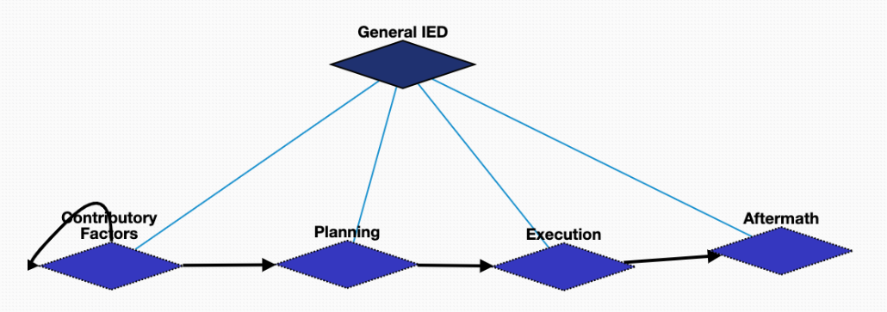
General IED Schema Overview

Slide 16
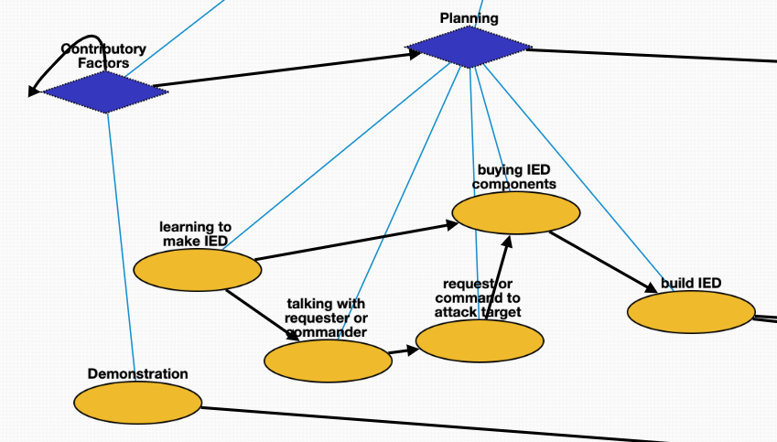

General IED: Contribution Factors & Planning
Demonstration | Q175331 | demonstration that triggered the bomb
learning to make IED | Q8434 | learn about the bomb making
talking with requester or commander | Q1472062 | asking the requester about the bomb plan
request or command to attack target | Q1665268 | requester asks to attack a specific target
buying IED components | Q21651837 | buy the materials to make the bomb
build IED | Q187939 | manufacturing the bomb

Slide 17
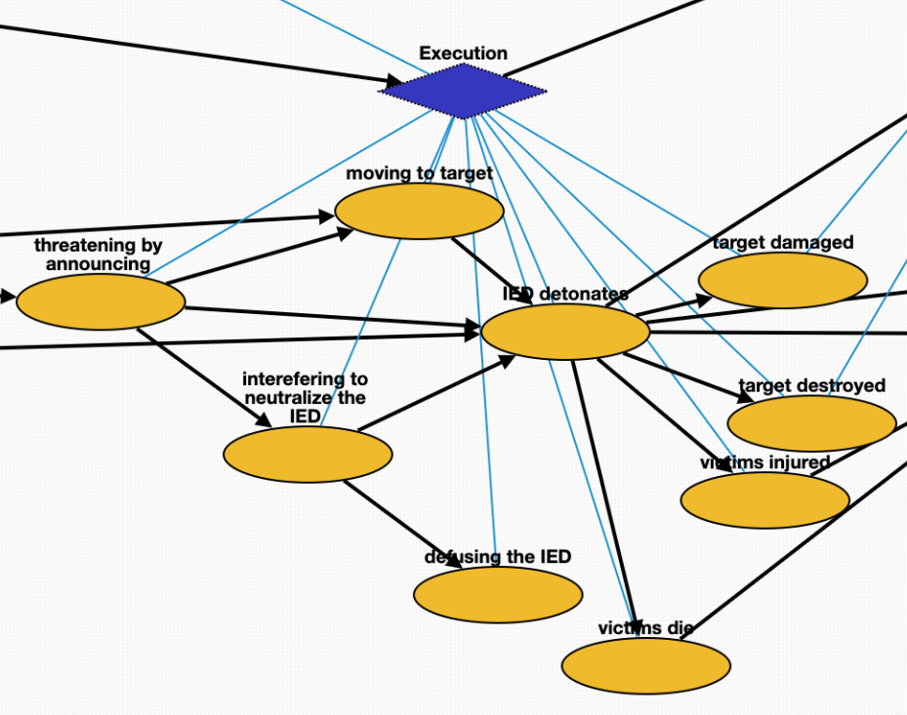
General IED: Execution
threatening by announcing | Q325980 | threatening the possible bombing
moving to target | Q7590 | transport the bomb to the target
interefering to neutralize the IED | Q16515105 | interefer the bombing
defusing the IED | Q649416 | leave the bomb
IED detonates | Q891854 | bomb attack starts
target destroyed | Q17781833 | destruction of the target
target damaged | Q481609 | damage of the target
victims injured | Q193078 | injury of victims
victims die | Q4 | death of victims
interefering to defuse more potential IEDs | Q16515105 | interefer other remaining bombs
Investigation begins | Q1964968 | criminal investigation

Slide 18
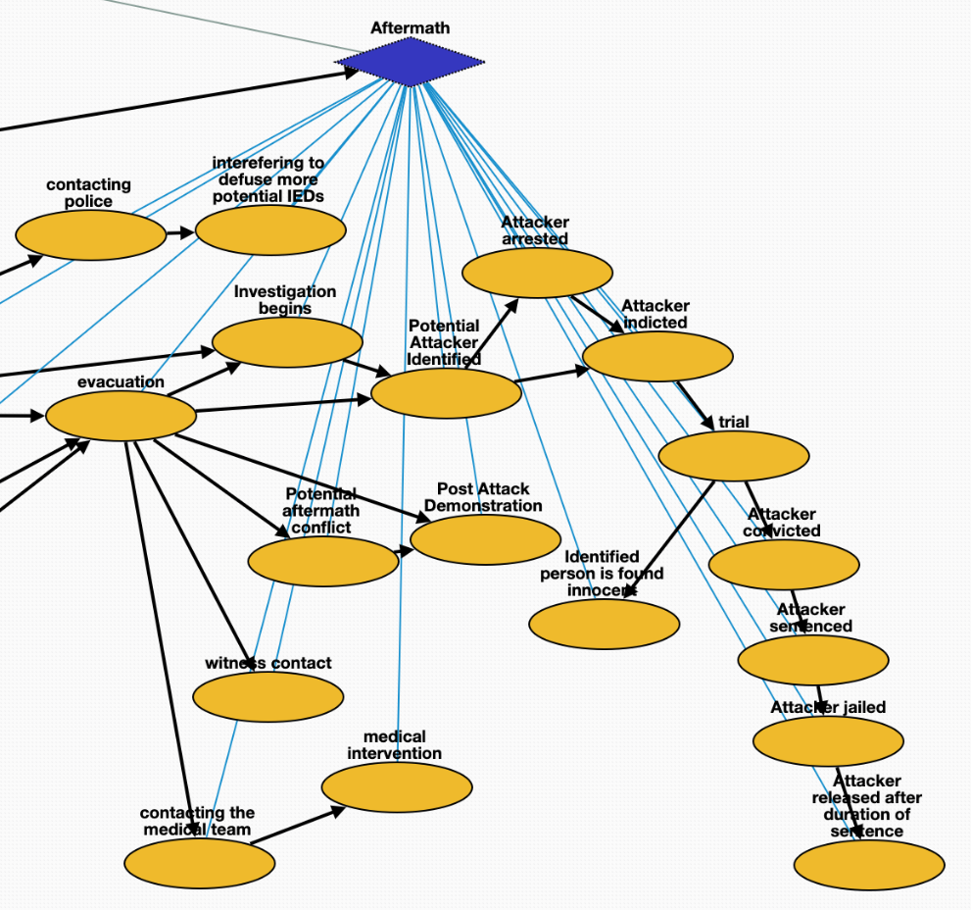
General IED: Aftermath
interefering to defuse more potential IEDs | Q16515105 | interefer other remaining bombs
Investigation begins | Q1964968 | criminal_investigation
evacuation | Q606332 | emergency_evacuation
witness contact | Q11024 | communication with witness
A demonstration event happening after the detonation event. | Q175331 | demonstration after the bombing
Potential aftermath conflict | Q1174599 | attack after the bombing
evacuation | Q606332 | emergency_evacuation
contacting the medical team | Q1472062 | contacting the medical team
contacting police | Q1472062 | contacting the police
Intelligence identified ibrahim hussein berro as bomber at some place. | Q3265221 | identification of the bomber
Attacker indicted | Q19357312 | accusation of the bomber
trial | Q545861 | legal_hearing
Attacker convicted | Q2916183 | conviction of the bomber
Attacker sentenced | Q1763090 | sentence of the bomber
Attacker jailed | Q1403016 | arrest of the bomber
Attacker released after duration of sentence | Q3237993 | release the bomber from prison
Identified person is found innocent | Q3237993 | release the innocent people

Slide 19
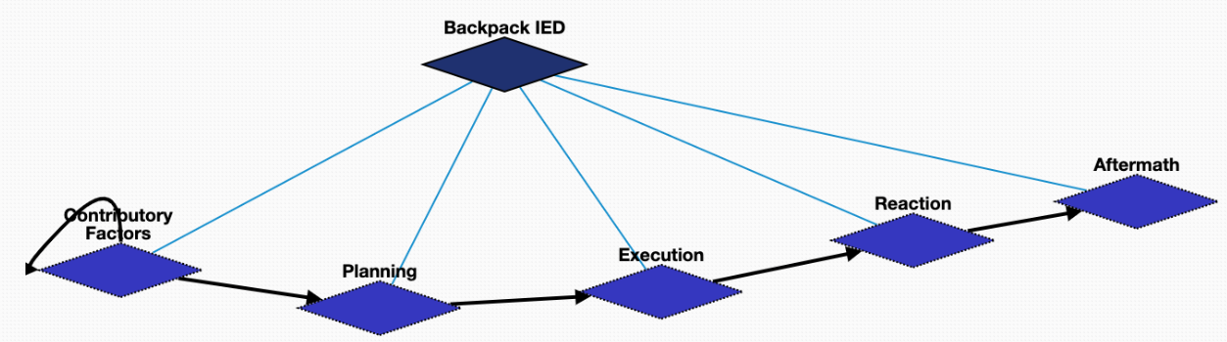
Backpack IED

Slide 20
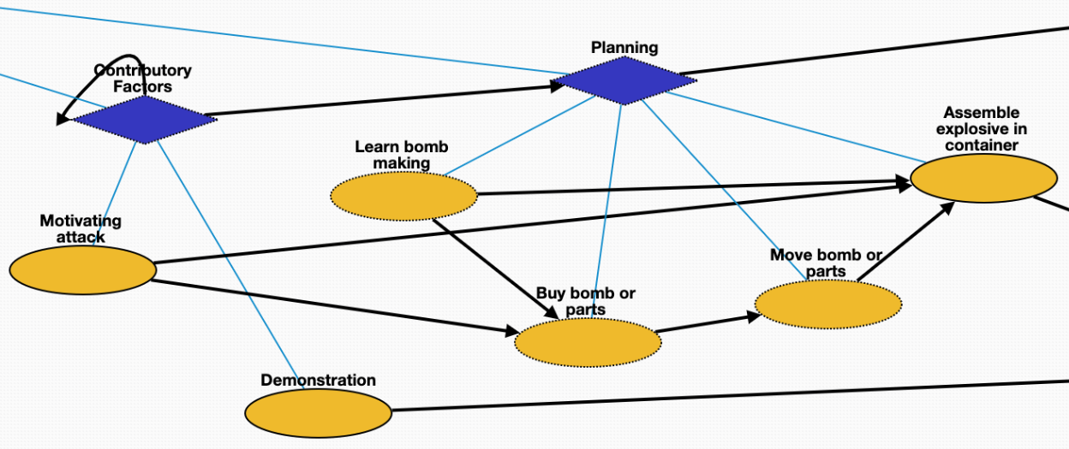
Backpack-IED Schema: Contributory Factors & Planning
Learn bomb making | Q8434 | learn about the bomb making
Motivating attack | Q1174599 | the bomber starts to want to attack people
Buy bomb or parts | Q21651837 | but materials for the bomb
Move bomb or parts | Q7590 | transport the bomb
Assemble explosive in container | Q187939 | manufacturing the bomb
Demonstration | Q175331 | demonstration that triggered the bomb

Slide 21
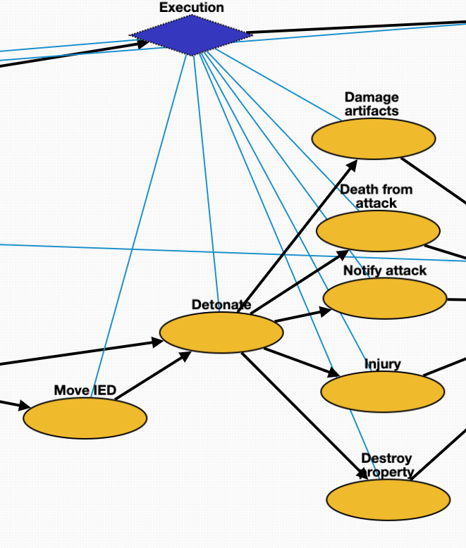
Backpack-IED Schema: Execution
Damage artifacts | Q481609 | damage by the bomb
Injury | Q193078 | victim injury
Detonate | Q891854 | bomb attack
Destroy property | Q17781833 | destruction of the surrounding properties
Death from attack | Q4 | death due to the attack
Move IED | Q7590 | transport IED to the attacking target
Notify attack | Q1472062 | announcement of the attacking event

Slide 22
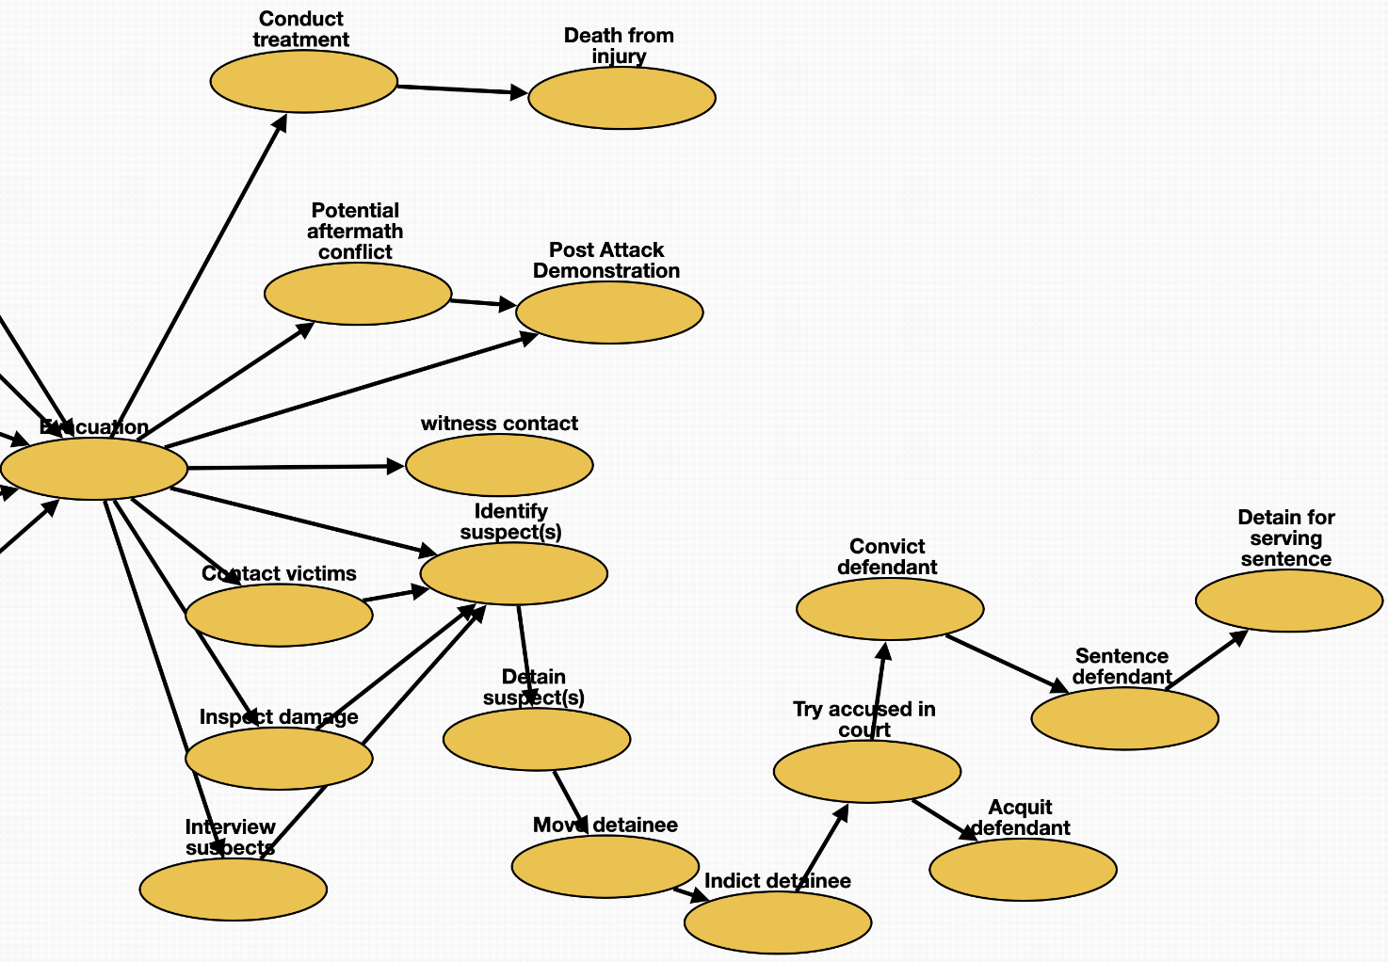
Backpack-IED: Reaction & Aftermath
Evacuation | Q606332 | emergency evacuation
Potential aftermath conflict | Q1174599 | attack after the bombing
Post-Attack Demonstration | Q175331 | demonstration after the bombing
Conduct treatment | Q179661 | treatment for victims
Evacuation | Q606332 | emergency_evacuation
witness_contact | Q11024 | communication with the witness
Identify suspect(s) | Q3265221 | identification of the bomber
Notify attack | Q1472062 | notification of the attack
Contact victims | Q11024 | communication with the victims
Inspect damage | Q193181 | observation of the demage
Interview suspects | Q21170798 | meeting with suspects
Move detainee | Q7590 | transport the detainee
Indict detainee | Q19357312 | accusation of the bomber
Detain suspect(s) | Q1403016 | arrest the bomber
Try accused in court | Q545861 | legal_hearing
Acquit defendant | Q1454723 | acquittal of the bomber
Convict defendant | Q2916183 | conviction of the bomber
Sentence defendant | Q1763090 | sentence of the bomber
Detain for serving sentence | Q1403016 | arrest the bomber

Slide 23
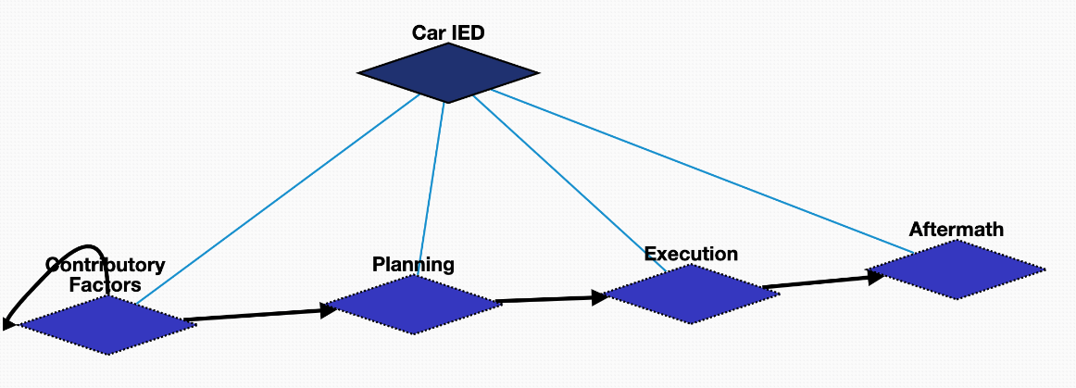
Car IED

Slide 24
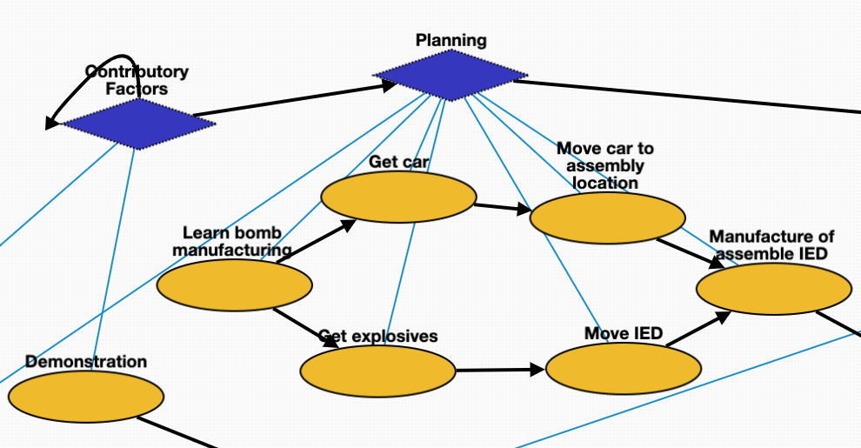
Car IED: Contributing Factors & Planning
Demonstration | Q175331 | demonstration that triggered the bomb
Learn bomb manufacturing | Q8434 | learn about bomb making
Get explosives | Q21651837 | buy the materials to make the bomb
Get car | Q21651837 | buy the vehicle
Manufacture of assemble IED | Q187939 | manufacturing the bomb
Move IED | Q7590 | transport the bomb to some place
Move car to assembly location | Q7590 | transport the vehicle to some place

Slide 25
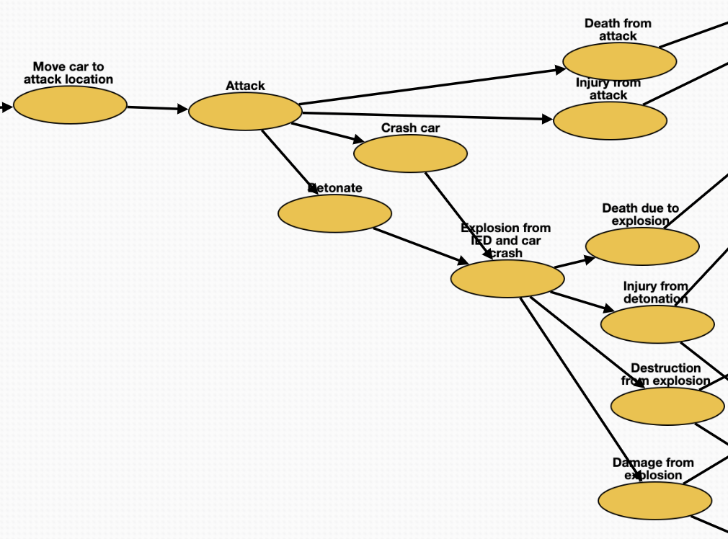
Car IED: Execution
Attack | Q1174599 | attack
Detonate | Q891854 | bomb_attack
Crash car | Q11822042 | crash the car and the bomb
Explosion from IED and car crash | Q179057 | explosion
Injury from attack | Q193078 | injury from the attack
Destruction from explosion | Q17781833 | destruction from the explosion
Damage from explosion | Q481609 | damage from the explosion
Death from attack | Q4 | death from the attack
Injury from detonation | Q193078 | injury from the explosion
Medical intervention | Q179661 | treatment for victims
Death due to explosion | Q4 | death from the explosion
Move car to attack location | Q7590 | transport the car to attack people

Slide 26
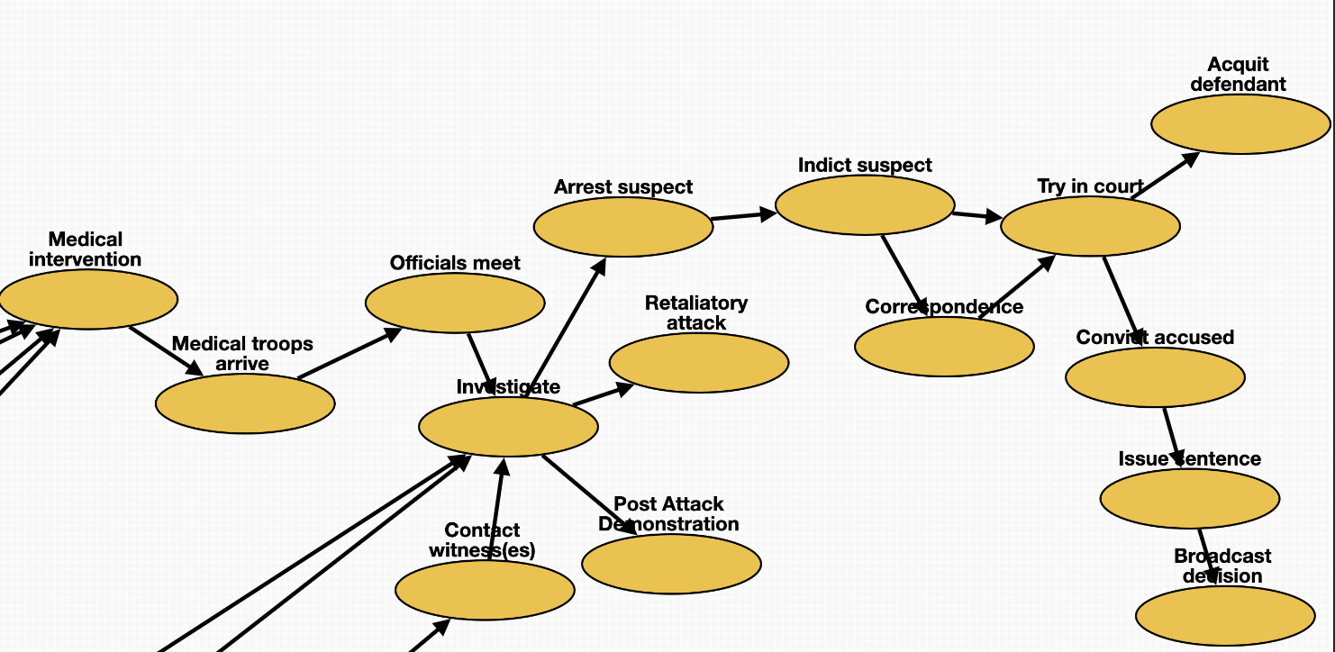
Car-IED: Aftermath
Acquit defendant | Q1454723 | acquittal of the attacker
Medical intervention | Q179661 | treatment for the victim
Contact witness(es) | Q11024 | communication with the witness
Try in court | Q545861 | legal_hearing
Officials meet | Q21170798 | meeting with officials
Investigate | Q1964968 | criminal_investigation
Retaliatory attack | Q1174599 | attack after the bombing
Arrest suspect | Q1403016 | arrest the bomber
Indict suspect | Q19357312 | accusation of the bomber
Correspondence | Q1472062 | remote_communication with witness
Convict accused | Q2916183 | conviction of the bomber
Broadcast decision | Q567303 | announcement of the final decision
Issue sentence | Q1763090 | sentence of the bomber
Medical troops arrive | Q7590 | medical team arrives

Slide 27
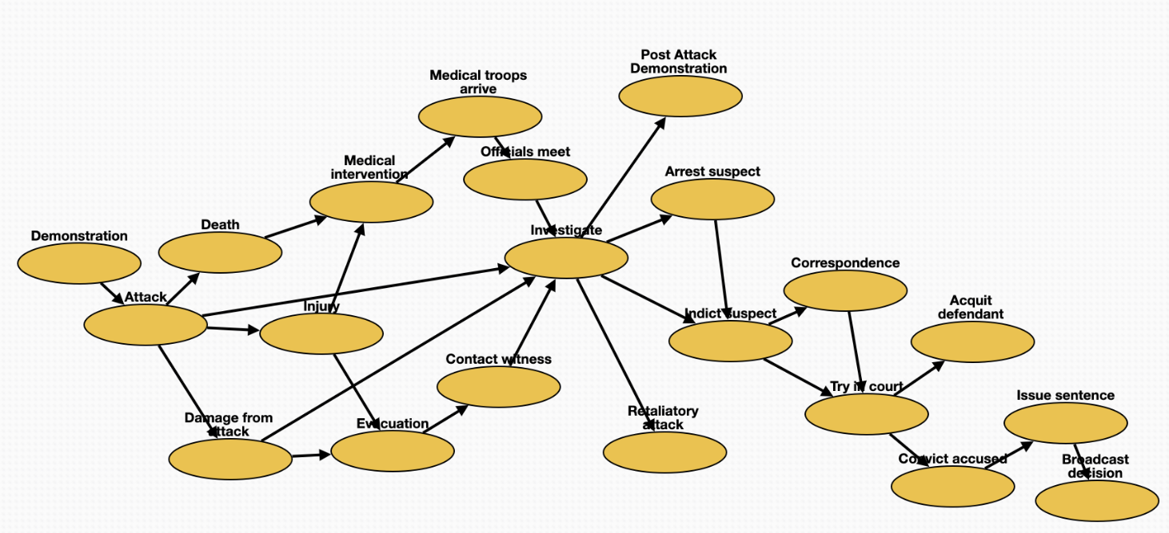
General Attack Schema
Medical intervention | Q179661 | treatment of the victims
Arrest suspect | Q1403016 | arrest suspects
Try in court | Q545861 | legal_hearing
Officials meet | Q21170798 | meeting with officials
Investigate | Q1964968 | criminal_investigation
Evacuation | Q606332 | emergency_evacuation
Contact witness | Q11024 | communication with witness
Demonstration | Q175331 | demonstration that triggered the attack
Post-Attack Demonstration | Q175331 | demonstration after the attack
Retaliatory attack | Q1174599 | attack after the previous attack
Indict suspect | Q19357312 | accusation of the attacker
Correspondence | Q1472062 | remote_communication
Convict accused | Q2916183 | conviction of the attacker
Broadcast decision | Q567303 | announcement
Issue sentence | Q1763090 | sentence
Attack | Q1174599 | attack happens
Damage from attack | Q481609 | damage from the attack
Acquit defendant | Q1454723 | acquittal of the attacker
Death | Q4 | death of the victims
Medical troops arrive | Q7590 | medical team arrives
Injury | Q193078 | injury of victims

Slide 28
RESIN Terrorist Attacks Schema Quizlet 9
Iris Liu, Sha Li, Michael Regan,
Susan Brown, Martha Palmer, Heng Ji

Slide 29
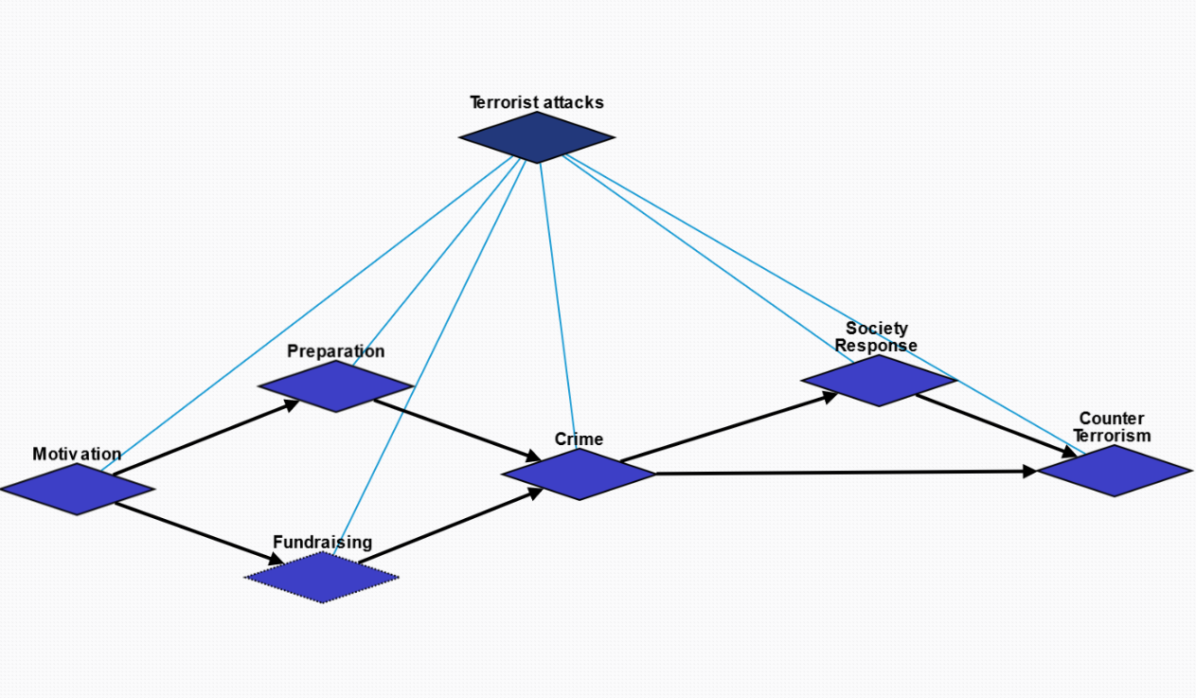
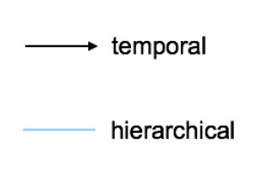
Overview

Slide 30
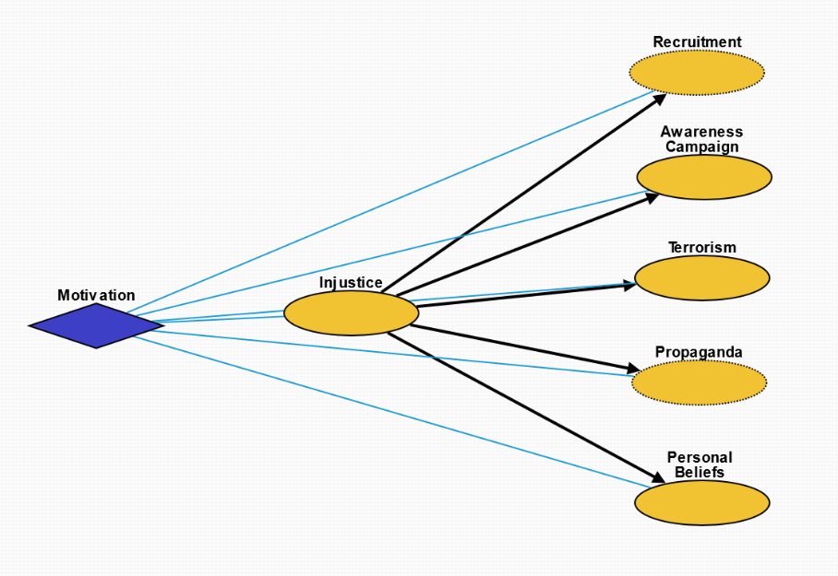
Motivation (10184)
Injustice (10190): Injustice, whether objective or perceived, towards a group or individual.
Recruitment (10194): Inspire people to join the cause.
Propaganda (10191): Crime as propaganda to inspire people for the cause.
Awareness Campaign (10192): Raise awareness and receive attention from the media on the cause.
Terrorism (10193): Incite fear in the general population.
Personal Beliefs (10195): Personal beliefs that something about the world is inherently wrong.

Slide 31
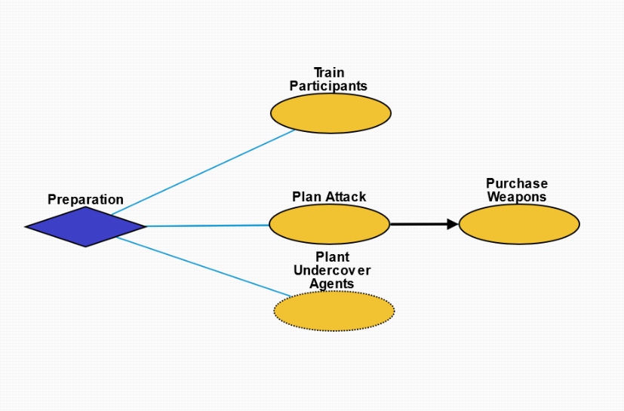
Preparation (10185)
Train Participants (10197): Train participants who will execute the attack.
Plan Attack (10196): Plan the specifics of attack.
Purchase Weapons (10199): Obtain weapons for the crime.
Plant Undercover Agents (10198): Plant spies in the target group to obtain information.

Slide 32
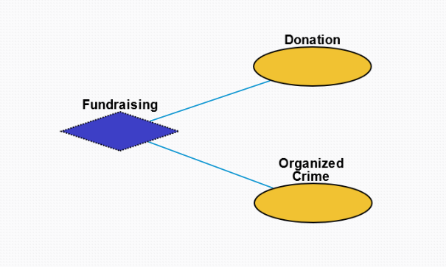
Fundraising (10186)
Donation (10200): Monetary donation from supporters.
Organized Crime (10201): Criminal enterprises for the purpose of profit.

Slide 33
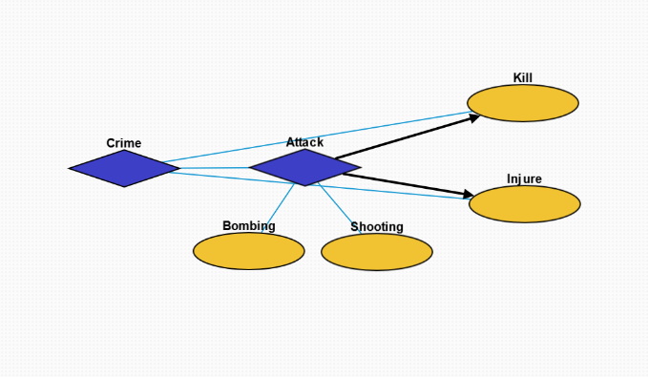
Crime (10187)
Attack (10202): Terrorist action to injure another organism.
Bombing (10205): Action whereby a bomb is used to kill one or more people or to damage or destroy objects
Shooting (10206): Act or process of firing firearms or other projectile weapons
Kill (10204): Killing an individual or group.
Injure (10203): Injuring an individual or group.

Slide 34
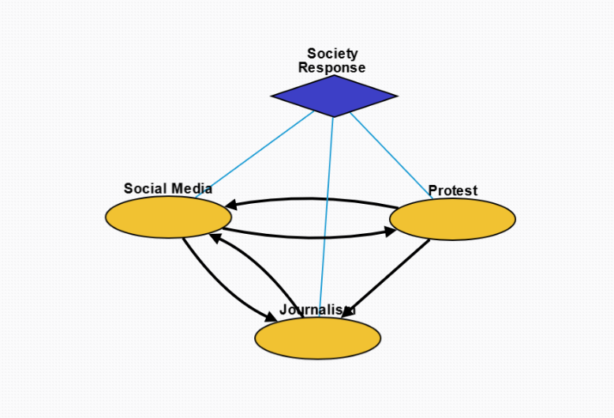
Society Response (10189)
Social Media (10207): Interaction among people in which they create, share, and/or exchange information and ideas in virtual communities and networks.
Protest (10217): Collective action by people to protest the terrorist attack and injustice.
Journalism (10208): Investigation and reporting of events, issues and trends to a broad audience.

Slide 35
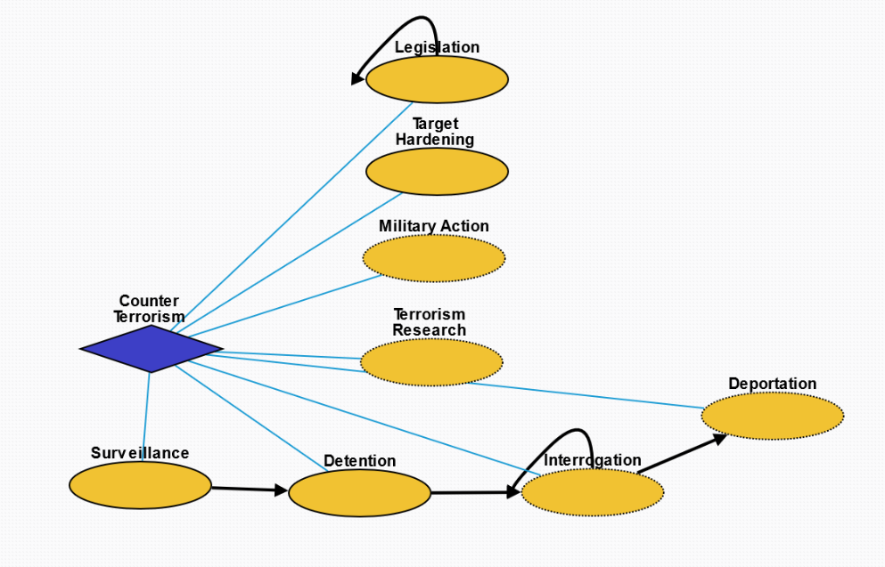
Counter Terrorism (10188)
Legislation (10211): Laws enacted against terrorism.
Target Hardening (10214): Process of securing or strengthening security of an area suspected to be targeted by terrorism.
Military Action (10209): Control of people by others through violence in order to prevent further terrorist activity.
Terrorism Research (10215): Systematic research into the cause of terrorism and its impact as well as preventative measures.
Surveillance (10216): Monitoring of behavior, activities, or other changing information, for the purpose of influencing, managing or directing.
Detention (10212): Removal of the freedom of liberty by a state.
Interrogation (10213): Interviewing employed by law enforcement officers, military personnel, and intelligence agencies with the goal of eliciting information about affiliation with any terrorist group.
Deportation (10210): Expulsion of the people from a place or country.

Slide 36
RESIN Kidnapping Schema
Quizlet 9

Slide 37
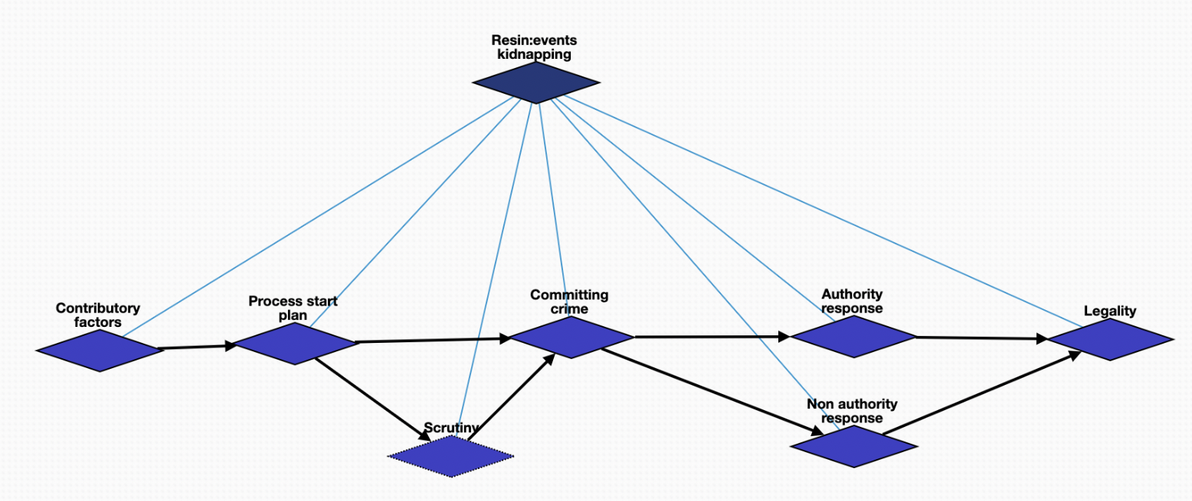
Overview

Slide 38
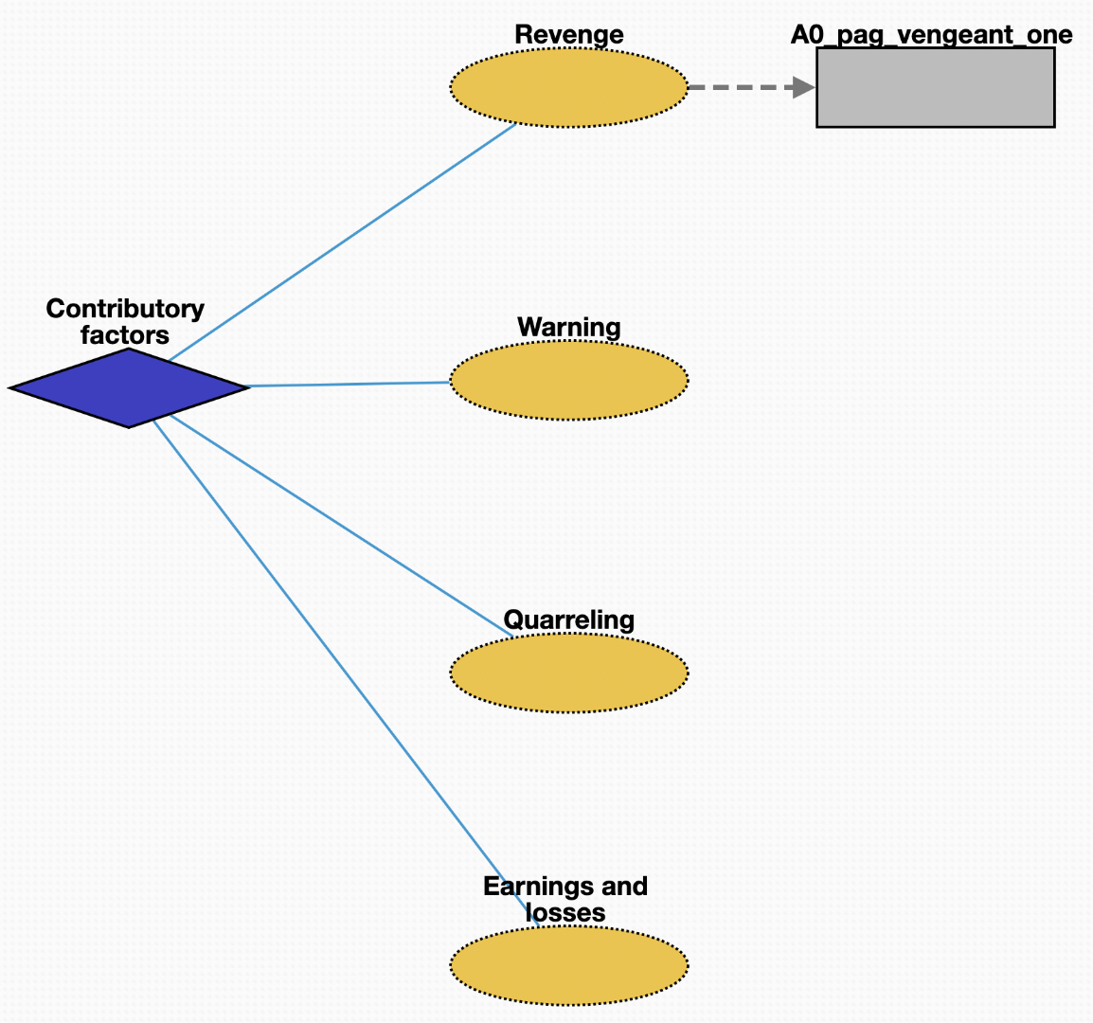
Contributory factors (10219)
Revenge (10228): harmful action in response to a grievance
Warning (10229): preventative measure taken to ensure someone's health
Quarreling (10227): struggle for agency or power in society
Earnings and losses (10226): consumption and savings opportunity gained by an entity within a specified timeframe

Slide 39
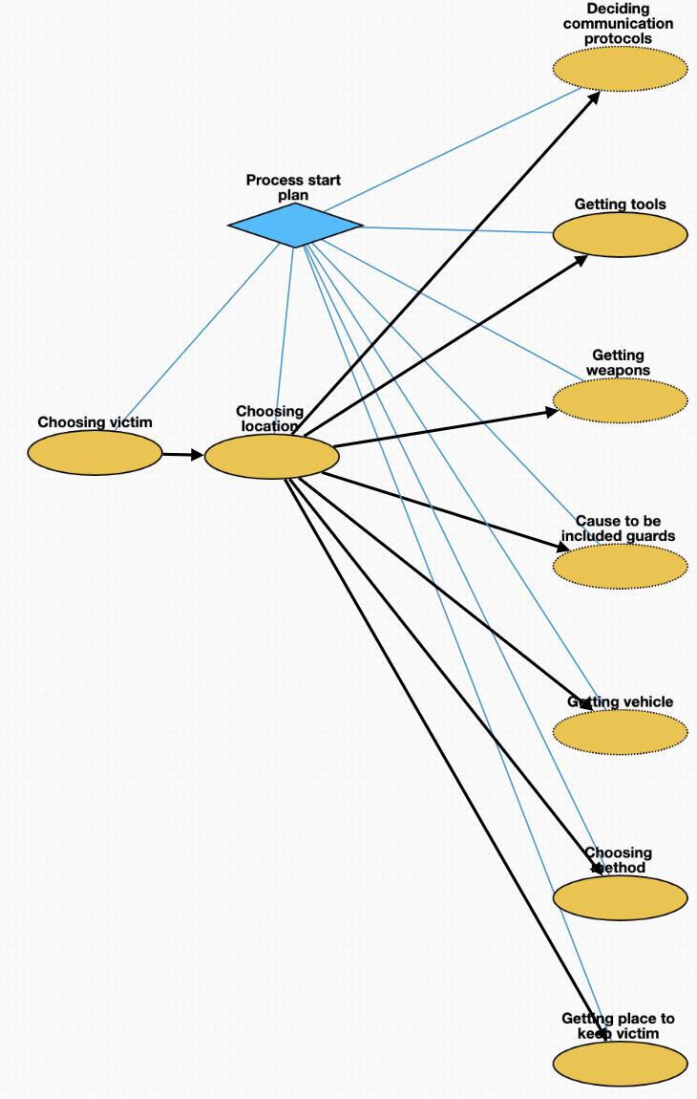
Planning (10220)
Choosing victim (10230): act of selecting one or more victims
Choosing location (10231): act of selecting location where to kidnap victim
Deciding communication protocols (10233): deliberation about how kidnappers should communicate before, during, and after the crime
Getting tools (10234): purchase of tools necessary for crime
Getting weapons (10236): purchase of weapons needed for crime
Cause to be included guards (10238): employment of personnel needed to guard victim
Getting vehicle (10235): purchase of vehicle needed for crime
Choosing method (10232): act of judging the merits of multiple kidnapping methods and selecting one or more of them
Getting place to keep victim (10237): acquisition of location where victim will stay

Slide 40
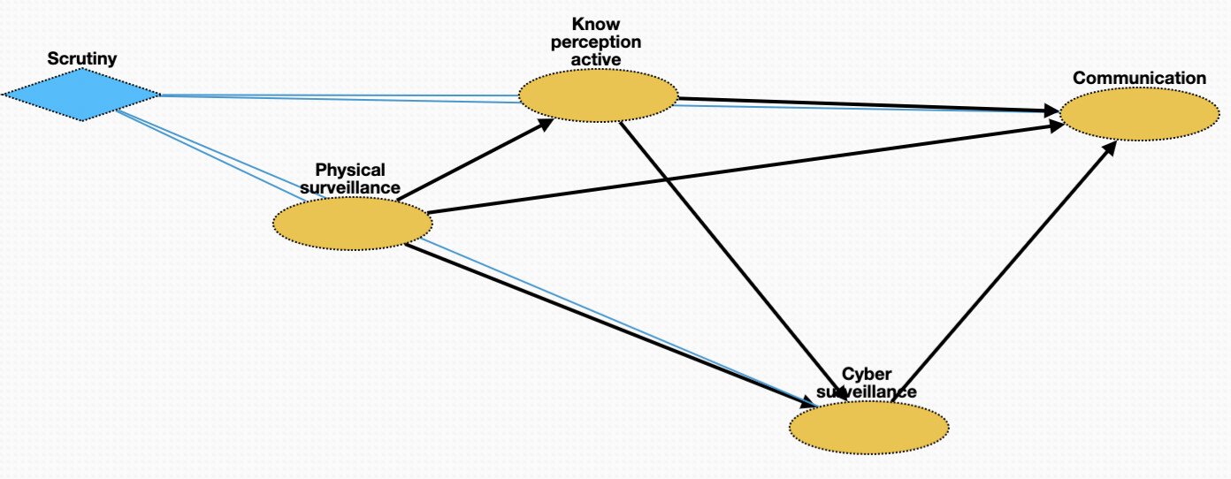
Scrutiny (10221)
Physical surveillance (10239): monitor of behavior, activities, or other changing information about victim
Know perception active (10240): mental process; act of recognizing attributes of victim
Cyber surveillance (10241): clandestine acquisition of confidential information about victim via online resources
Communication (10242): act of conveying intentions about kidnapping to other members of criminal network

Slide 41
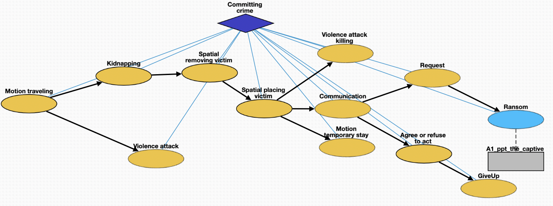
Committing crime (10222)
Motion traveling (10243): movement of kidnapper from a place to location where is planned
Attack (10244): control of victim by kidnapper
Kidnapping (10245): taking away or transportation of a person against that person's will
Removing victim (10246): process removing the victim from a location
Placing victim (10247): net movement of victim from one location to another
Killing (10254): death of victim as a result of action by kidnapper
Temporary stay (10250): short stay of victim in safehouse or other location
Communication (10248): act of conveying intended meanings from kidnapper to authorities or non-authorities
Request (10249): act of asking formally for something in return for safety of victim
Ransom (10251): practice of holding a prisoner or item to extort money or property
Agree or refuse to act (10253): understanding between entities to follow a specific course of conduct
GiveUp (10252): form of surrender when kidnapper decides to stop crime

Slide 42
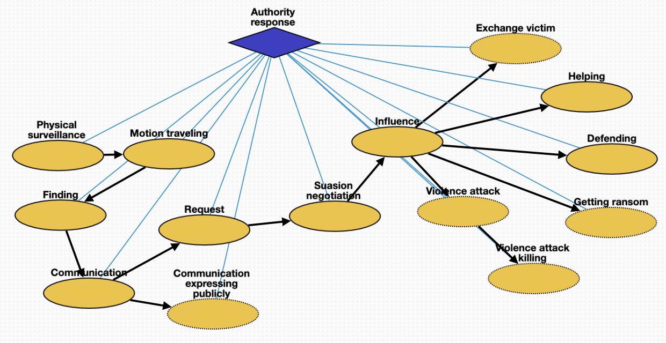
Authority response (10223)
Physical surveillance (10255): monitoring of behavior, activities, or other changing information about kidnapper
Traveling (10256): movement of authorities to location of kidnapper or victim
Finding (10257): physical finding of location of kidnapper or victim
Communication (10258): act of conveying intended meanings between authorities
Expressing publicly (10259): revealing of restricted information about crime to public
Request (10260): act of asking formally for demands of kidnapper
Negotiation (10261): meeting held between authorities and kidnapper
Influence (10262): umbrella term of influence and mode of communication
Helping (10265): cooperation between authorities and people impacted by crime
Defending (10264): act of protecting victim from attack
Exchange victim (10268): voluntary exchange of victim for other person or resource
Getting ransom (10263): money made available to secure safety of victim
Attack (10266): attempt to control situation by authorities
Killing (10267): act of killing the kidnapper or accidental killing of victim

Slide 43
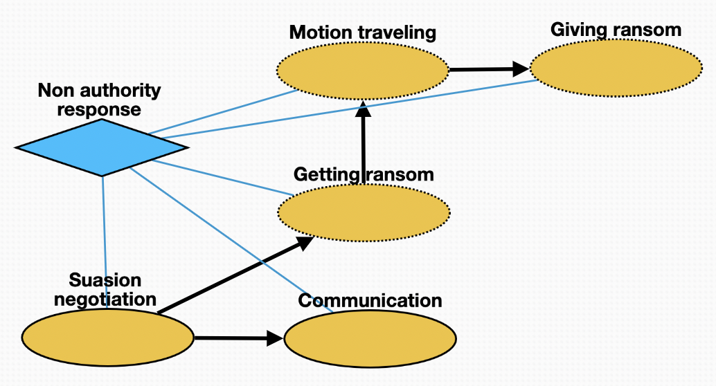
Non-authority response (10224)
Negotiation (10269): meeting held between non-authorities and kidnapper
Communication (10273): conveying meaning between non-authorities and kidnapper
Getting ransom (10270): procuring money to secure safety of victim
Traveling (10272): movement of non-authorities to location for delivery of ransom
Giving ransom (10271): handing over ransom to kidnapper

Slide 44
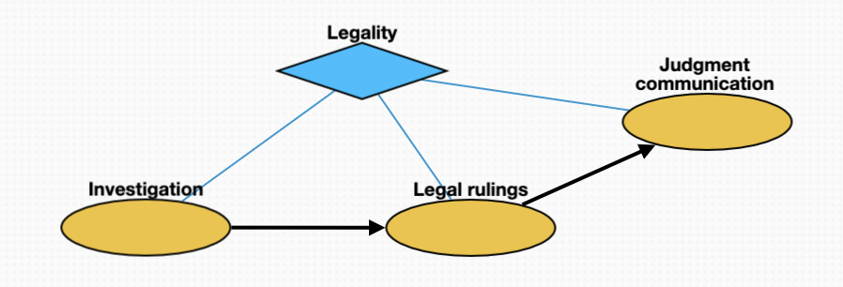
Legality (10225)
Investigation (10274): investigation of crimes by police
Legal rulings (10275): proceedings in any civil lawsuit or criminal prosecution
Judgment communication (10276): instruction directed by law, judgment or administrative act to defendant or litigant to obey a certain behavior

Slide 45
Business Change Schema Quizlet 9
Carl Edwards
{cne2}@illinois.edu

Slide 46
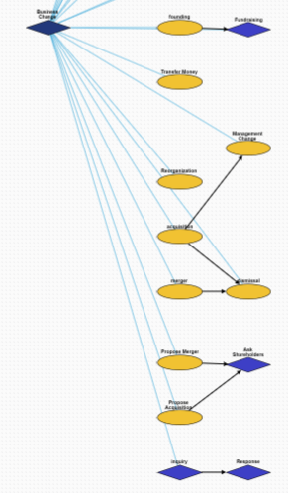
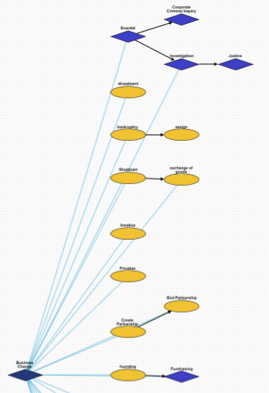
Overview

Slide 47
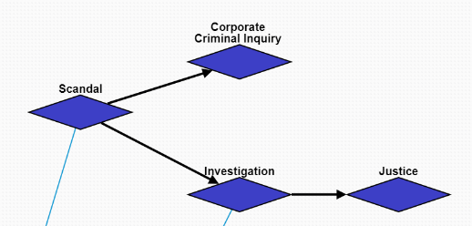
Scandal
10464:Scandal: A scandal occurs at the company.
10494:Investigation->10523:Justice: This branch involves the investigation and justice of an individual person.
10494:Corporate Criminal Inquiry: This branch involves the company as a whole being investigated for crimes.

Slide 48
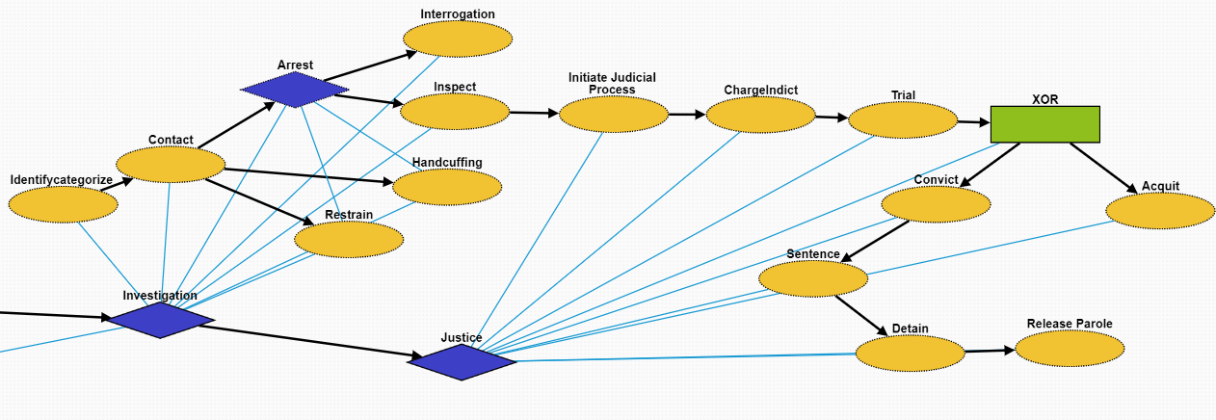
Investigation
This is the same as Criminal Justice in Quizlet 8.
10510:Identifycategorize: Identification of the suspect.
10511:Contact: Make contact with the suspect
10512:Arrest: Taking the suspect who violated laws during the outbreak into custody
10524:Handcuffing: Using handcuffs to secure a suspect who violated law
10526:Restrain:Physical restraint on the suspect
10525:Interrogation: Interviewing with the goal of eliciting useful information related to suspected crime
10513:Inspect: Organized examination or formal evaluation on the suspect

Slide 49
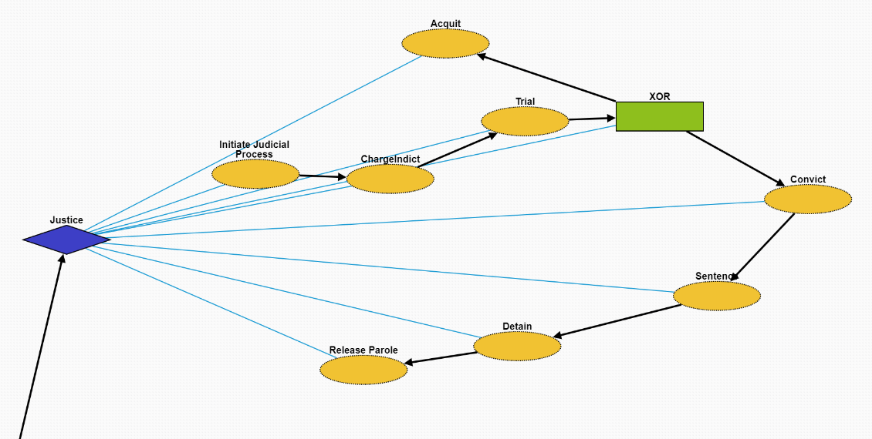
Justice
This is the same as Criminal Justice in Quizlet 8.
10514:Initiate Judicial Process: Initiate a legal proceeding on the suspect.
10515:ChargeIndict: Formal accusation made by a governmental authority on the suspect.
10516:Trial: Coming together of parties to a dispute, to present information in a tribunals on the case.
10521:Acquit: In common law jurisdictions, an acquittal certifies that the accused is free from the charge of an offense, as far as the criminal law is concerned
10517:Convict: A state or private citizen lawfully holds the criminal responsible by removing their freedom or liberty at that time.
10518:Sentence:
10519:Detain:
10520:Release Parole: Release or early release of the criminal responsible.

Slide 50
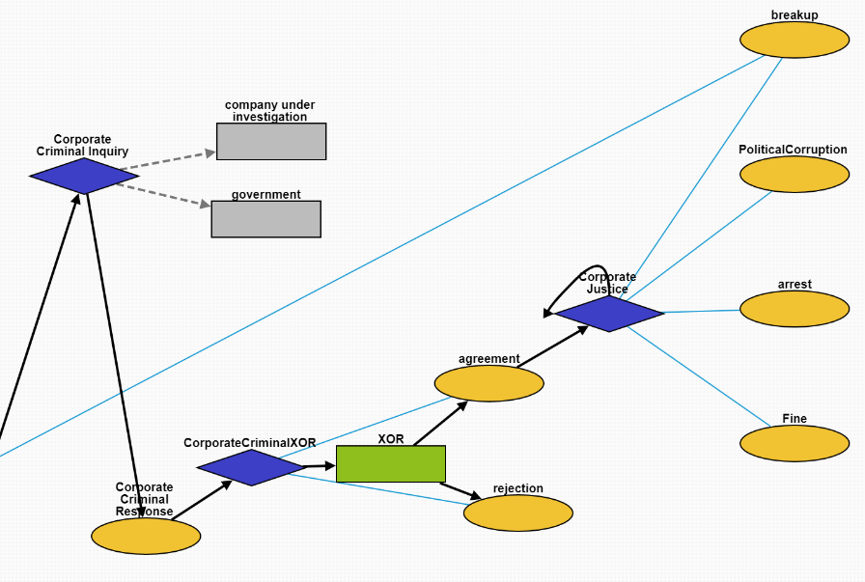
Corporate Criminal Inquiry
10492:Corporate Criminal Response: A response to a corporate criminal investigation. Created to distinguish from criminal response against people.
10503:CorporateCriminalXOR: Node to enable XOR children.
10501:agreement: The government decides a corporation broke the law.
10502:rejection: The government decides a corporation did not break the law.
10465:Corporate Justice: Government actions taken as a result of investigating a corporation.
10496:breakup: Government breaks up a company.
10466:PoliticalCorruption: The execs send money to their politician friends who pull some strings.
10495:arrest: Executives are arrested for crimes they committed carrying out their duties.
10484:Fine: The government fines a company for doing something wrong.

Slide 51
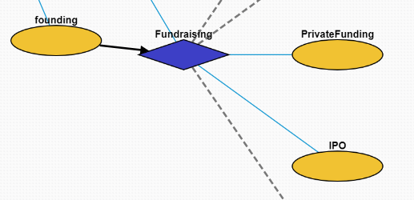
Fundraising
10462:founding: A company is founded.
10469:Fundraising: The company raises money for some goal.
10471:PrivateFunding: The company raises money from private investors (the opportunity is not available to the public).
10470:IPO: The company becomes publicly listed on a stock exchange.

Slide 52
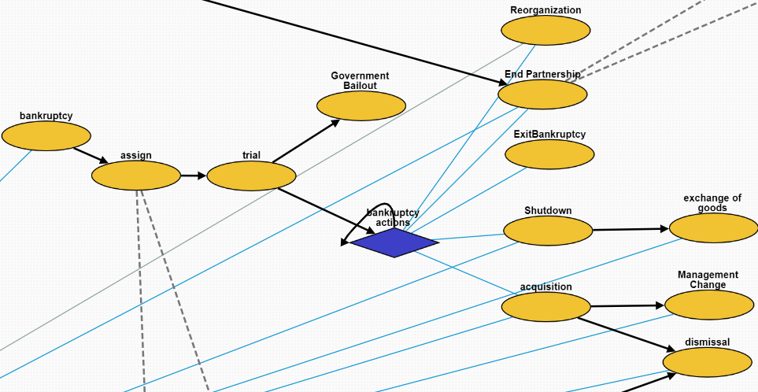
Bankruptcy
10475:assign: Government assigns a trustee to the bankruptcy case.
10476:trial: A bankruptcy case begins.
10480:Government Bailout: The government loans a lot of money to a company when it's 'too big too fail' without damaging the economy.
10472:bankruptcy actions: Different actions taken when the company is undergoing the bankruptcy process.
10461:Reorganization: The company is reorganized.
10482:End Parternship: Two companies decide to end their partnership.
10483:ExitBankruptcy: A company leaves bankruptcy.
10460:Shutdown: A company has to close for some reason.
10456:acquisition: A company is acquired by another company.
10473:exchange of goods: A company sells its assets.
10479:Management Change: The management is changed.
10504:dismissal: A bunch of employees are fired.

Slide 53
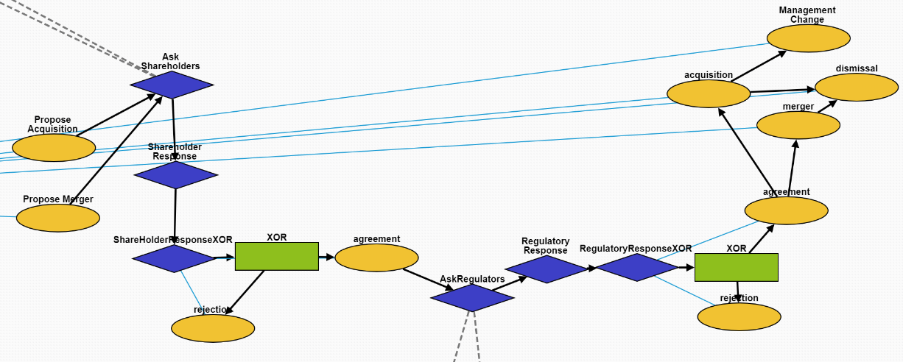
Propose Acquisition/Merger
10487:Propose Acquisition: One company proposes acquiring another company.
10486:Propose Merger: Two companies decide to try and become one company.
10505:Ask Shareholders: The companies ask their shareholders for approval.
10506:Shareholder Response: The shareholders respond.
There is also a XOR version (10509) to indicate only one child answer.
10507,10488:agreement: A positive response.
10508,10489:rejection: A negative response.
10485:AskRegulators: Ask the regulators to approve the merger/acquisition.
10491:Regulatory Response: The regulators respond.
There is also a XOR version (10490) to indicate only one child answer.
10457:merger: The companies merge together.
10456:acquisition: One company acquires another.
10504:dismissal: Employees are fired from a company.
10479:Management Change: The managers of a company are
replaced with new managers.

Slide 54
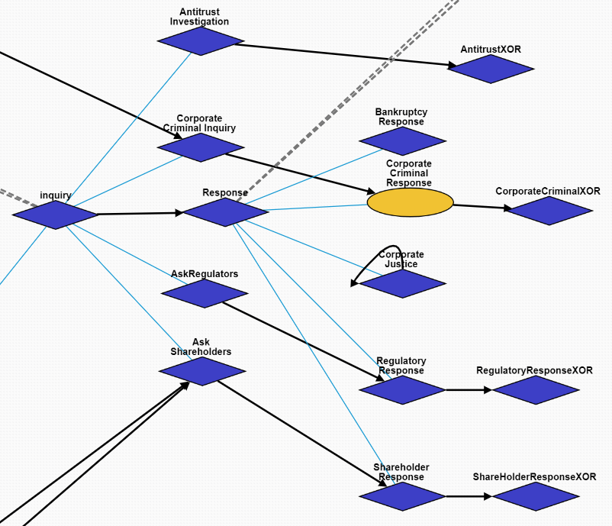
Inquiry/Response Superclasses
Overall hierarchy structure of Inquiry and Response

Slide 55
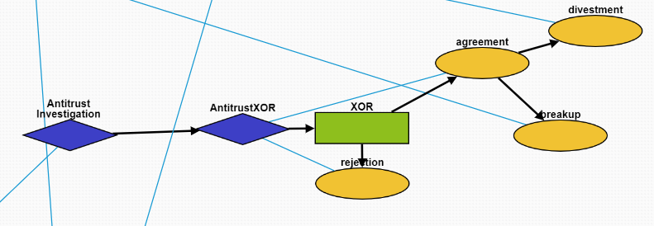
Antitrust Investigation
10497:Antitrust Investigation: The government investigates whether a company is a monopoly.
There is also a XOR version (10500) to indicate only one child answer.
10498:agreement: A positive response.
10499:rejection: A negative response.
10458:divestment: The company is forced to sell off parts of its business by the government.
10496:breakup: The company is broken up into smaller pieces by the government.

Slide 56

Other Business Change Events
10458:divestment: A company divests assets.
10460:Shutdown: A company shuts down.
10473:exchange of goods: A company sells assets.
10496:breakup: A company breaks up into smaller companies.
10474:Privatize: A public company’s stocks are bought up and it becomes private again.
10481:Create Partnership: Two companies partner together to do something mutually beneficial. They remain seperate entities.
10482:End Partnership: Two companies stop working together.
10477:Transfer Money: Money is transferred between two parties. This can be internal in a company.
10461:Reorganization: The structure of a company is reorganized.
10504:dismissal: Workers are fired.

Slide 57
RESIN Election Schema Quizlet 9
Charles Yu

Slide 58

Overview

Slide 59

Nomination episode
nomination – container for the episode declare candidacy – a person declares themselves a candidate for nomination campaign – a candidate campaigns throughout the political region debate – a candidate attends debates with other candidates to clarify their political platform drop out – a candidate may drop out of the race endorse candidate – a candidate who has dropped out will typically endorse a different candidate whose views best align with theirs unofficially nominated – a candidate is unofficially nominated (i.e., they received a majority of votes already) announce running mate – a candidate will announce their running mate for their ticket party convention – a political party will hold a convention to discuss their overall platform for the election officially nominated – a candidate is officially declared a party’s nominee campaign – next episode

Slide 60

Campaign episode
campaign (diamond shape) – container for the episode speech – a candidate will give a speech about their platform to generate hype and support campaign (ellipse shape) – candidate will hold rallies or meet and greets to generate support fundraising – candidate will raise funds to support their campaign advertising – candidate will run advertisements to reach a wider audience debate – candidate will attend debates with other candidates media appearance – candidate will appear in the media via interviews and events
voting – next episode

Slide 61

Vote episode
vote – container for the episode vote early – some voters will follow a special process to vote early go to polling site – some voters will vote on election day at the polling site mail in ballot – some voters will mail in a ballot to vote votes verified – votes are counted and verified to prevent fraud winner declared – the winner of the election is declared based on the votes
conclude – next episode

Slide 62

Conclude episode
conclude – container for the episode inauguration – the winner of the election is inaugurated deny result – a loser of the election may deny the result of the election incite violence – a loser of the election may incite violence to try to overturn the result lawsuit – a loser of the election may sue in order to attempt to overturn the result coup d'état – a loser of the election may attempt a coup

Slide 63
RESIN Sports_Games Schema

Slide 64

Overview

Slide 65

Preparation
Bids for hosting the event: for major sports events, such as modern Olympics games and various National Games, nations or cities should put forth bids for hosting the event.
Announcement of the event: the decision of bids are typically announced through a press conference.
Competition scheduling: to schedule the grouping and matching of participating teams, and settling down the time and location of matches.
Boycott the event: sometimes certain nations or individual athletes will boycott a sports game for political or humanitarian reasons.
Training of participating athletes: before major competitions, athletes needs specific training to achieve better performance.

Slide 66

Sports Event
Opening ceremony: opening ceremony represents the official commencement of a major sports event.
Sports competition: a specific competition in which the participants rival with each other to win the game
Overtime (extra time): Overtime or extra time is an additional period of play specified under the rules of a sport to bring a game to a decision and avoid declaring the match a tie or draw where the scores are the same.
Violence in sports: violent and often unnecessarily harmful intentional physical acts committed during, or motivated by, a sports game. This may include violence between athletes or fan violence.
Closing ceremony: the official ceremony which marks the end of the sports event.

Slide 67

Social Response
Post-match press conference: athletes and coaches are usually invited to press conference to express feelings after a match is completed.
Fans cheering: fans of the winning team / athlete cheering to express happiness and excitement.
War triggered by a sports event: in very rare cases, the riots happened in a sports game will escalate to wars between participating nations, such as the 1969 Football War between El Salvador and Honduras.

Slide 68
RESIN Terrorist Mass Shooting Schema Quizlet 9
Ghazaleh Kazeminejad, Sha Li, Iris Liu, Michael Regan,
Susan Brown, Martha Palmer, Heng Ji

Slide 69

Overview

Slide 70

Motive (10296)
Failure (10303): state or event of not meeting a desirable or intended objective, relative to a particular observer or belief system
Social conflict (10301): struggle for agency or power in society, when two or more actors oppose each other in social interaction
Revenge (10302): harmful action in response to a grievance

Slide 71

Planning (10297)
Intentional human activity (10304): human activity driven by purposeful motives
Decision (10305): result of deliberation
Buy (10306): purchase weapon for crime
Announcement (10307): printed, spoken, or published statement or notice of intent of mass shooting

Slide 72

Attack (10298)
Motion (10308): change in position of an object over time; a body is said to be in motion if it changes its position with respect to its immediate surroundings
Gun violence (10309): broadly defined as violence committed with the use of a gun
Injury (10312): physiological wound caused by shooter
Killing (10311): act of killing a living being
Survival (10313): act of being still alive after a threatening or dangerous situation
Violent death (10310): death caused by violence through the shooting

Slide 73

Medical Response (10299)
Emergency call (10314): way of contacting an emergency call center usually by a phone to an emergency telephone number
Driving (10315): operation of a vehicle to the crime scene
First aid (10316): first and immediate assistance given to any person suffering from shooting injury
Rescue (10317): comprises responsive operations that usually involve the saving of life, or prevention of injury

Slide 74

Criminal Investigation (10300)
Accusation (10318): act of accusing or charging another with a crime
Arrest (10319): detention of a person and taking them into custody, usually because it has been suspected of committing a crime
Detention (10320): removal of the freedom of liberty by a state
Conviction (10321): verdict that results when a court of law finds a defendant guilty of a crime
Plea (10322): answer to a claim made by someone in a criminal case under common law using the adversarial system
Trial (10323): coming together of parties to a dispute, to present information in a tribunal
Legal hearing (10324): A legal hearing about the crime
Court decision (10325): formal decision made by a court
Acquittal (10327): the legal result of a verdict of not guilty
Sentence (10326): decree of punishment in law
Imprisonment (10328): restraint of a person's liberty by judicial or other detention
Execution (10329): homicide as capital punishment

Slide 75
RESIN Civil Unrest Schema

Slide 76

Overview

Slide 77

Trigger (10544)
Crime (10549): crimes that seriously threaten social security and cause widespread concerns
Election (10552): the results of the election did not meet the expectations of some people or the fairness of the election was questioned
War (10550): people suffer from injustice or protracted wars
Legislation (10548): the legal provisions are unreasonable or against the requirements of some people
Trial (10551): trials of legal cases do not meet public expectations

Slide 78

Peaceful Protest (10545)
Inquiry (10556): people seek more information about the trigger
Investigation (10557): people investigate the process or truth of the trigger
Negotiation (10555): protesters try to communicate and negotiate to look for a solution
Demonstration (10535): protest activity taking the form of a public gathering of people in a rally or walking in a march
Strike (10553): workers refuse to work as a typical form of protest to gain a concession
Occupation (10554): protesters hold public spaces or critical infrastructure as an act of protest

Slide 79

Riot (10530)
Clash (10533): Protesters clash with police
Disperse (10537): police ordered the crowd to disperse
Robbery (10541): protesters looted surrounding shops or residents
Arson (10529): protesters set fire to surrounding buildings or objects
Destruction (10543): protesters causing damage to residents' property
Shoot (10536): police shoot criminals to maintain order
Injury (10532): people get injured in conflict
Death (10540): people die in conflict
Attack (10534): protesters attack police during clash
Emergency_evacuation (10542): residents evacuated from burning or destroyed buildings

Slide 80

Justice (10546)
Arrest (10531): police arrest some criminal or protester
Conviction (10561): protester guilty of breaking the law
Sentence (10539): protesters for breaking the law sentenced
Release (10560): protesters with minor or no offenses released

Slide 81

Response (10547)
Resignation (10558): the directors responsible for the incidence resign from the position
Public statement (10538): the head of government makes a public speech to call for clam and provide resolutions to the problem
Investigation (10557): head of government promises to re-investigate to meet public expectations

Slide 82
RESIN International Conflict Schema
Qi Zeng

Slide 83

Overview
International Conflict (10277)

Slide 84

Battle Episode (10286)
Attack (10278): A conflict between two countries
Scarcity (10282): Food or resource shortage caused by the attacks
Injury (10280): Victims get injured because of the attacks
Death (10279): Victims die because of the attack
Damage (10281): Constructions are damaged because of the attack
Transport (10283): Victims have to migrate to other places
Demonstration (10284): People demonstrate to against the battle
Arrest (10285): People triggering this attack is arrested

Slide 85

Ceasefire Episode (10292)
Remote Communication (10287): A third-party organization requests ceasefire
Negotiation (10288): Battle participants negotiate a ceasefire agreement
Negotiation Result (10289): a container
Rejection (10290): Battle participants do not reach an agreement
Agreement (10291): Battle participants reach an agreement
Announcement (10293): The ceasefire agreement is announced
Withdrawal (10294): The attacking army is withdrawn

Slide 86
RESIN Disaster and Rescue Schema Quizlet 9
Veronica Qing Lyu

Slide 87
Manmade Disaster and Rescue

Slide 88

Overview

Slide 89

Manmade disaster
Collapse (10602): Collapse of a building etc., in a disaster
Conflagration (10604): large and destructive fire that threatens human life, animal life, health, and/or property
Trap (10605): victims are trapped in the disaster site
Damage (10603): changes introduced into a system that adversely affect its current or future performance
Injury (10606): physiological wound caused by an external source
Death (10607): permanent cessation of vital functions

Slide 90

Rescue
Announcement (10608): government announces the disaster to public
Command (10609): government commands rescuers to carry out rescue
Communication (10610): rescuers communicate with trapped victims
Emergency_evacuation (10611): rescuers evacuate trapped victims
Collaboration (10612): different parties of rescuers collaborate
Transport (10613): rescuers transport victims to medical sites
Treatment (10614): medical treatment of the victims
Recover (10633): victims recover from injuries
Death (10634): permanent cessation of vital functions

Slide 91
Investigation
IdentifyCategorize (10616): Investigation of a manmade disaster includes identifying its initiators
Contact (10617): Make contact with the suspect
Arrest (10618): Taking the suspect who caused the disaster into custody
Inspect (10621): Organized examination or formal evaluation on the initiator of the disaster
Interrogation (10622): Interviewing with the goal of eliciting useful information related to suspected crime Handcuffing (10619): Using handcuffs to secure a suspect who initiated the disaster
Restrain (10620): Physical restraint on the suspect

Slide 92
Civil Justice
File Complaint (10623): Plaintiff files a complaint to initiate a lawsuit
Answer (10624): In law, a solemn assertion in opposition to someone or something by the defendant
Discovery (10625): Pre-trial procedure in common law countries for obtaining evidence
Motion (10626): In US law, a procedural device to bring a limited, contested issue before a court for decision
Trial (10630): Coming together of parties to a dispute, to present information in a tribunal
Judgement (10631): The formal decision made by a court following a lawsuit
Appeal (10632): Resort to a superior court to review the decision of an inferior court or administrative agency
Mediation (10628): Dispute resolution with assistance of an impartial third party moderator through the use of communication and negotiation techniques
Settlement (10629): The dispute is resolved through a payment of money

Slide 93
Natural Disaster and Rescue

Slide 94

Overview

Slide 95

Natural disaster
Tornado (10638): violently rotating column of air that is in contact with both the earth's surface and a cumulonimbus cloud in the air
Flood (10640): overflow of water that submerges land
Wildfire (10641): uncontrolled fire in an area of combustible vegetation that occurs in the countryside or a wilderness area
Earthquake (10657): result of a sudden release of energy in the Earth's crust that creates seismic waves
Tsunami (10642): series of water waves caused by the displacement of a large volume of a body of water
Thunderstorm (10643): type of weather
Trap (10639): victims are trapped in the disaster site
Injury (10644): physiological wound caused by an external source
Death (10645): permanent cessation of vital functions

Slide 96
Rescue
Announcement (10647): government announces the disaster to public
Command (10648): government commands rescuers to carry out rescue
Communication (10649): rescuers communicate with trapped victims
Emergency_evacuation (10650): rescuers evacuate trapped victims
Collaboration (10651): different parties of rescuers collaborate
Transport (10652): rescuers transport victims to medical sites
Treatment (10653): medical treatment of the victims
Recover (10655): victims recover from injuries
Death (10656): permanent cessation of vital functions

